Slide 1
Capstone Project – The Battle of Neighborhoods
Finding a better place to open a Chinese restaurant in New York City

Slide 2
Business Problem
New York City has attracted a lot of tourists and immigrants every year because of its diversity and activity in business and culture. The international environment has also simultaneously influenced its food culture and cuisines.
Chinese cuisine is becoming more and more popular in the United States that Chinese restaurants can be found almost everywhere, especially for the large cities like NYC. Opening a Chinese restaurant could bring a good business opportunity for success, however, cautions are needed to be taken when choosing the restaurant location in order to sustain a long-term success from the high competition.

Slide 3
Data Selection
New York City Neighborhood
A dataset that includes all the 5 boroughs and neighborhoods as well as geographical location of each neighborhood is downloaded from the IBM server or from the official website
https://geo.nyu.edu/catalog/nyu_2451_34572
Foursquare API Data
Information about all restaurants around every neighborhood within the radius of 1000 meters is collected from Foursquare, including the specified venue category, the longitude and latitude of the venue.

Slide 4
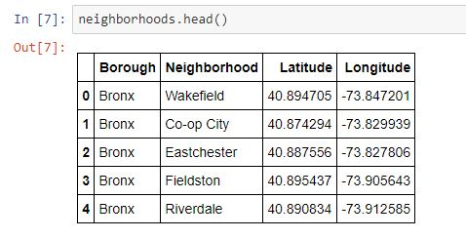
Methodology
The data cleansing has been carried out on the dataset of NYC neighborhood to extract the necessary information as follow

Slide 5
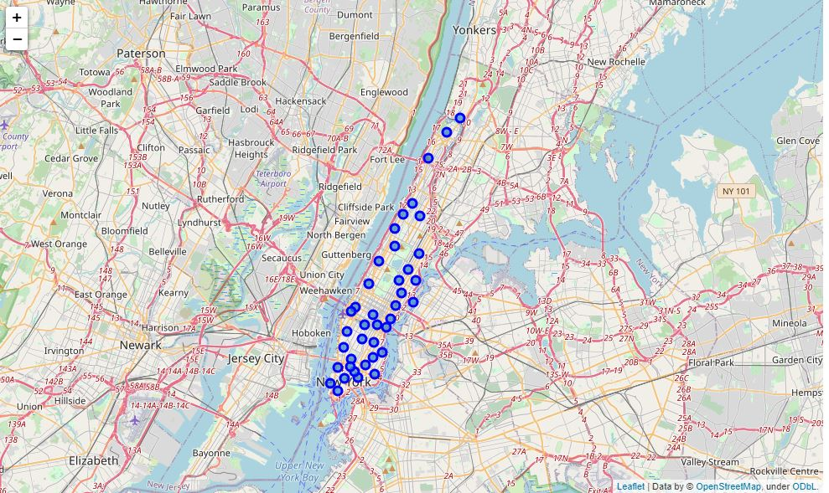
Methodology
The Foursquare API is applied to explore the neighborhoods in Manhattan, NYC.
Folium and Geopy will be applied to create a map of NYC with marks for each neighborhoods superimposed on top as shown below.

Slide 6
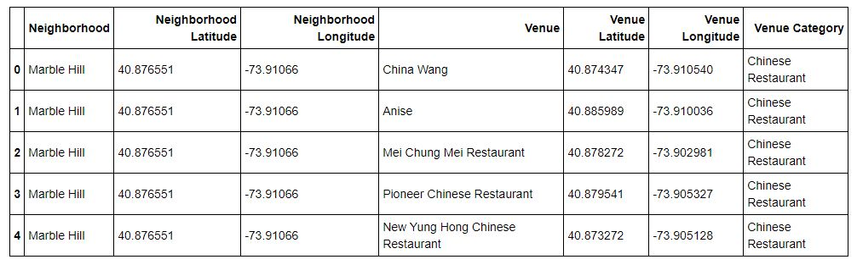
Methodology
Data about Chinese cuisine in Manhattan is generated by Foursquare API by providing different Chinese restaurants that are near to a neighborhood within the radius of 1000 meters

Slide 7
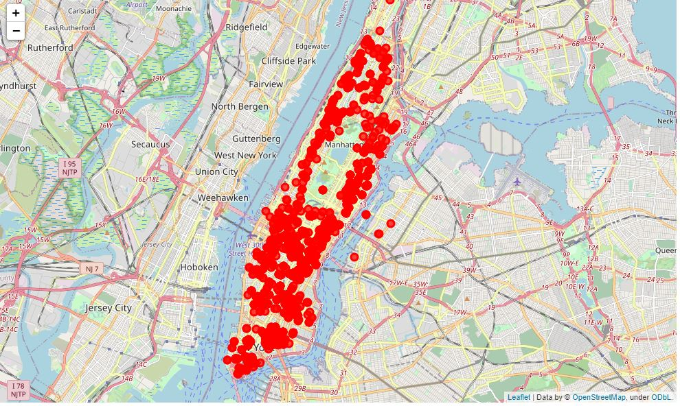
Methodology
The different kinds of Chinese restaurants in Manhattan area is shown as below

Slide 8
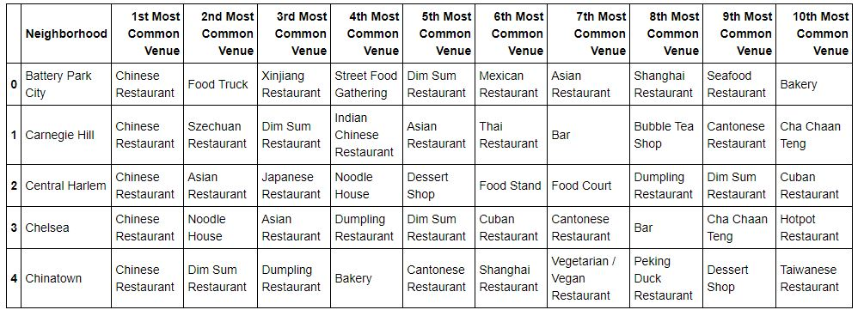
Methodology
One-hot Encoding has been used to find out what are the different kinds of Chinese restaurants present in each neighborhood and then calculate the top 10 Chinese restaurants based on the similarities.

Slide 9
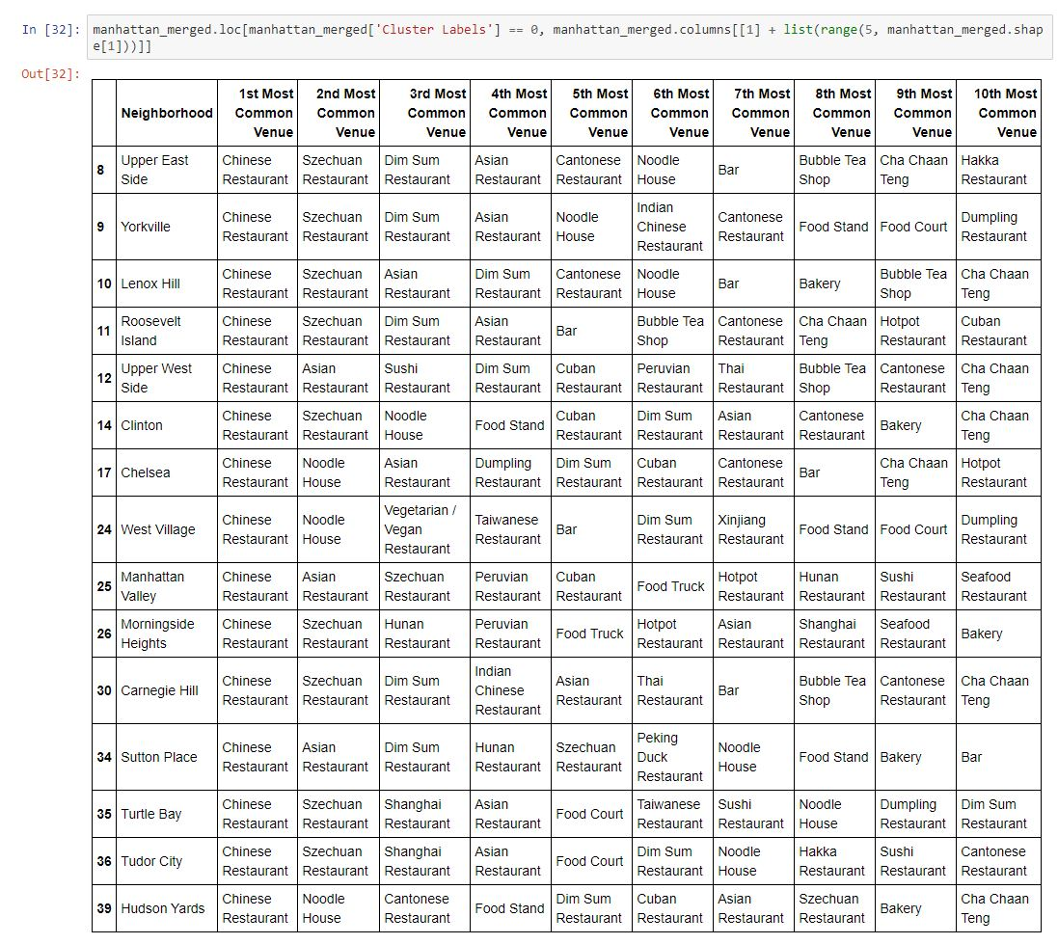
Results
The dataset has been clustered into 5 groups using K-Means clustering method, in which each member belongs to the cluster with the nearest mean. Each cluster has been expanded as follow
Cluster 1

Slide 10
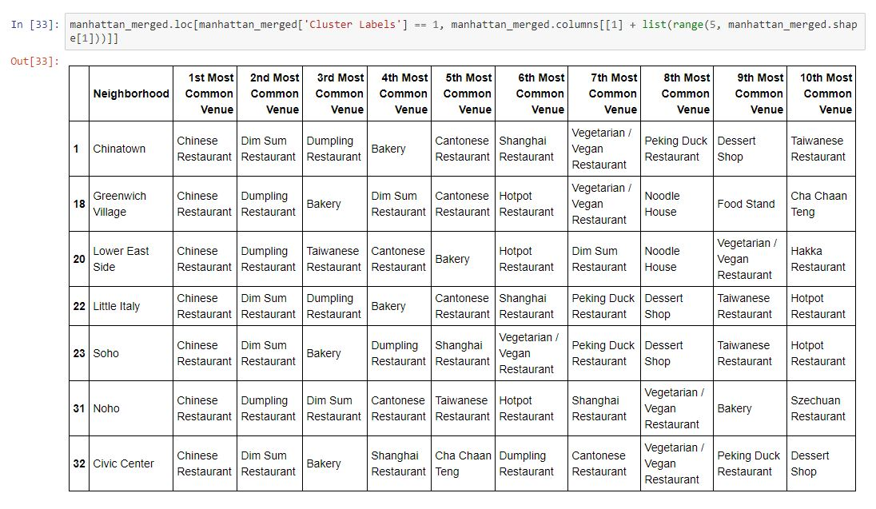
Results
Cluster 2

Slide 11
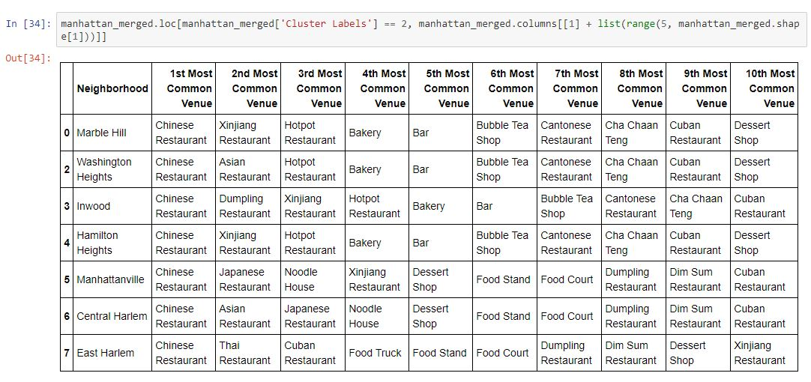
Results
Cluster 3

Slide 12
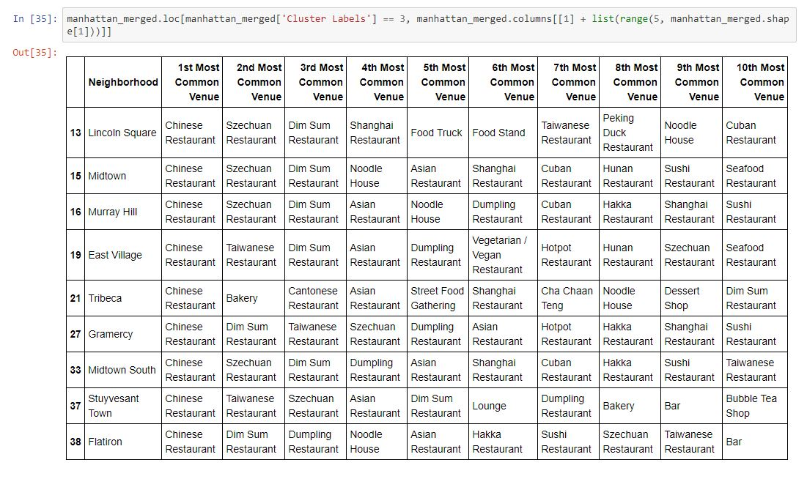
Results
Cluster 4

Slide 13
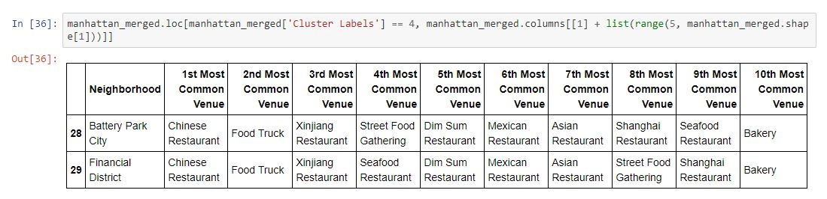
Results
Cluster 5

Slide 14
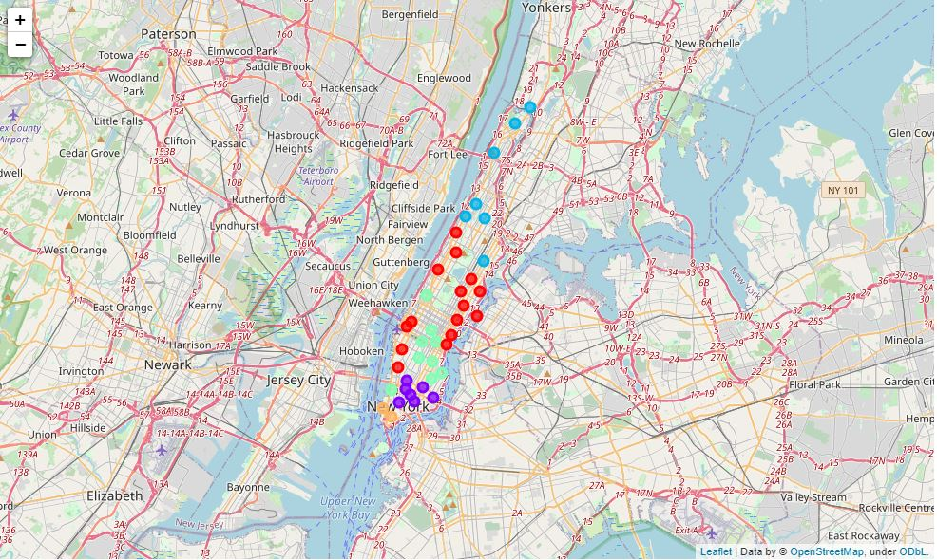
Results
K-Means clustering algorithm has been applied to group the similar neighborhoods into clusters together based on the distribution of existing Chinese restaurants

Slide 15
Conclusions
It is more preferable to open a new Chinese restaurant around northeast area in Manhattan, i.e., the intersection between cluster 1 and cluster 3, or central area, i.e., the intersection between cluster 1 and cluster 4, with lowest competition and risk.
The analysis could be more robust and convincing by considering some other factors such as transportations, housing prices and demographics.
In addition, other unsupervised learning methods can be used to solve the problem as density-based clustering.

